Slide 1
Data centres
This file contains snippets of graphs and things I found interesting or useful in crafting the projections of growth rates, new capacity, intensity, ai/data-centre capacity ratios and so on.

Slide 2
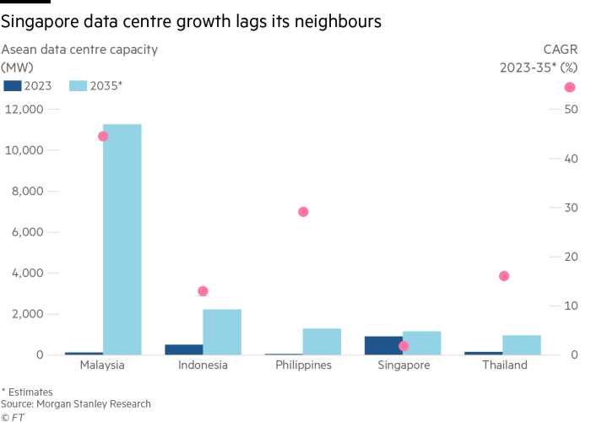
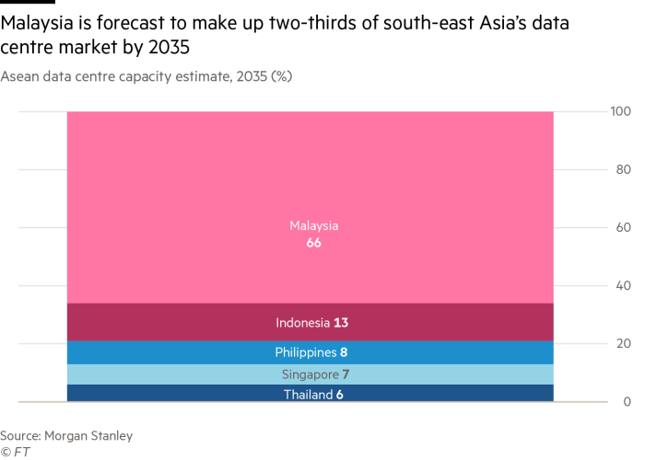

Slide 3
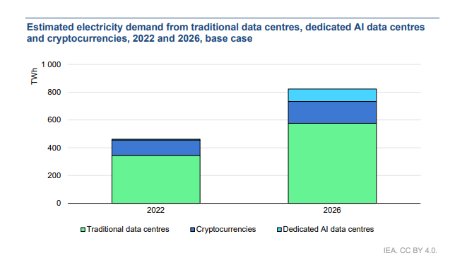
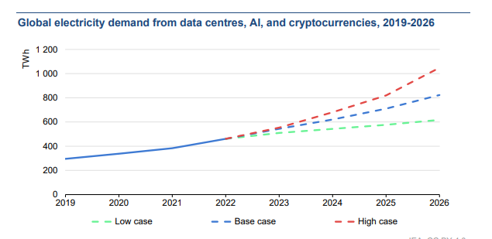
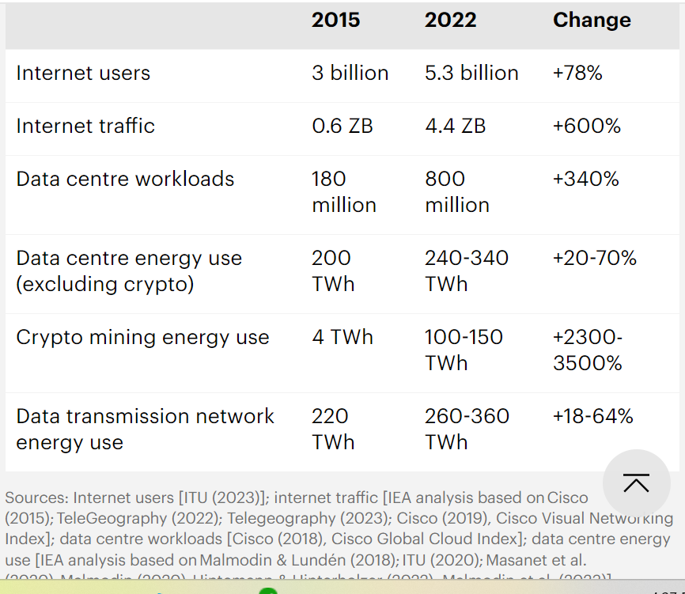
Iea – think its found by searching up ‘iea datacentres’

Slide 4
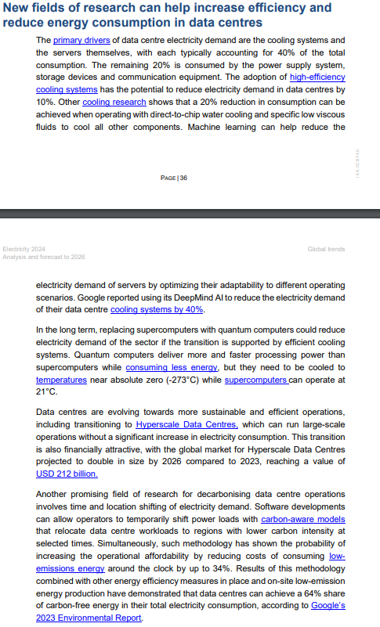
Iea cont.

Slide 5
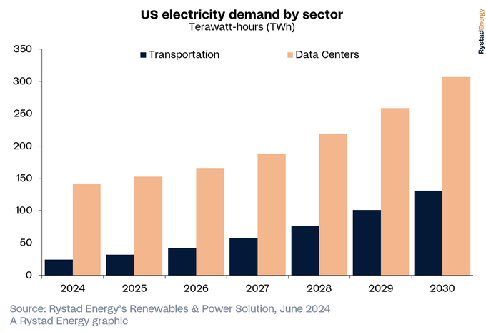

Slide 6
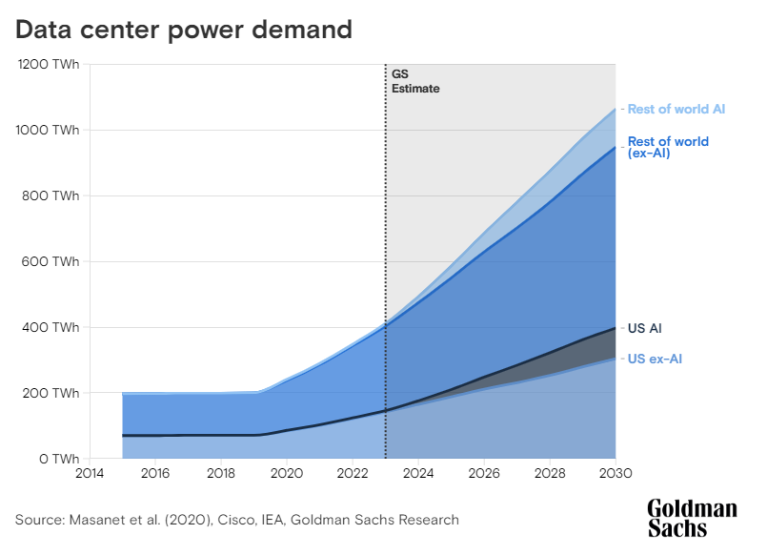

Slide 7
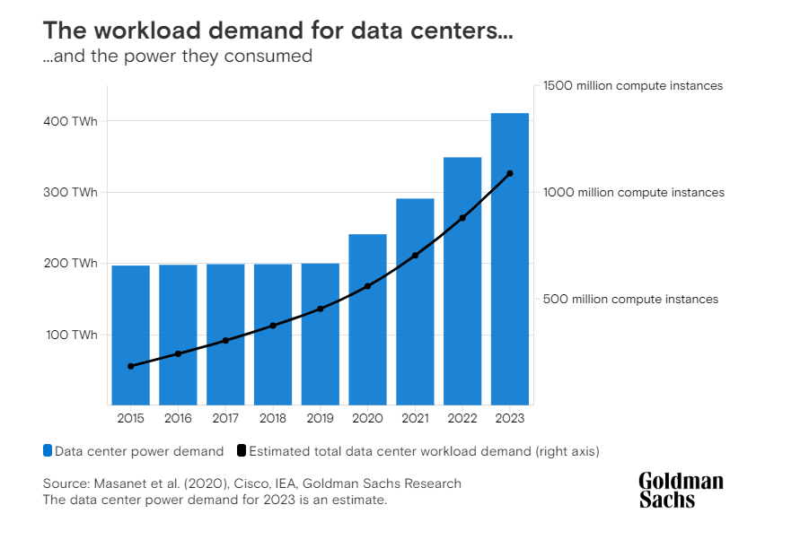

Slide 8
Important topics we could mention in discussion
Centralised/decentralized generation capacity for data centres.
If it is centralized it will help to encourage investment but cause short term issues with prices as supply is not available
If decentralized, we may see issues with pre-existing capacity being taken off the grid resulting in increased transmission costs for remaining consumers but it also may result in an increase in development of renewable baseload technology, which can be used for the main grid too/
Demand response ability/flexibility of data centres

Slide 9
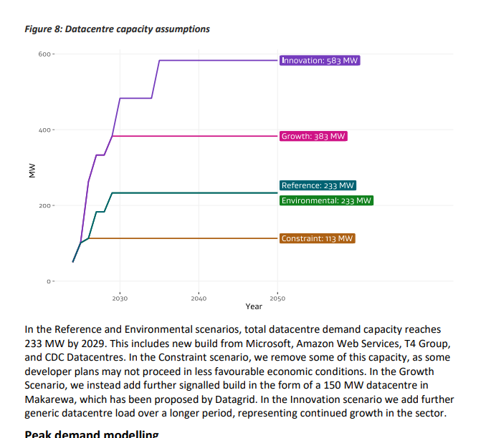
Nz edgs scenarios modelling

Slide 10
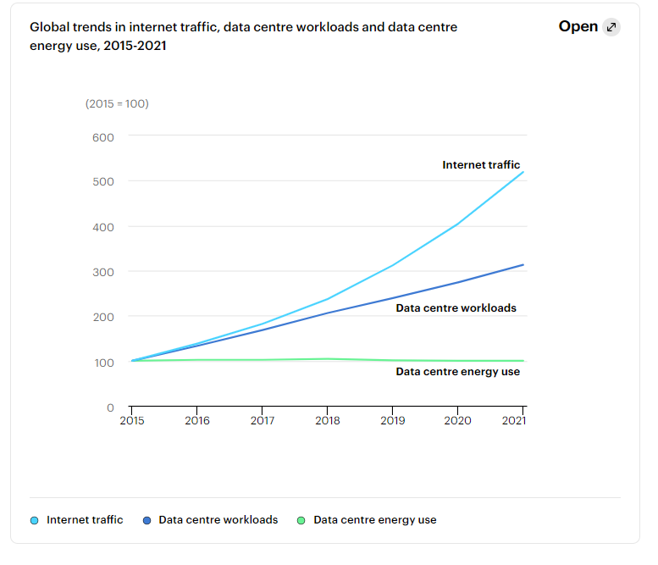
iea

Slide 11
Ideas for modelling
Split into 2 kinds:
Ai training and Cryptocurrencies
Based on trends and could be demand response enabled
Note that ai training is only 30% of the energy use associated with ai. 10% more for model development and testing, then 60% for use and inference. So this is really a small amount and not as important to consider?
General Data Center Usage (e.g. google/Netflix)
Majority of demand. Not flexible.
Includes use of ai tools (i.e. inference), but not training of them.
Can be estimated using an estimate of total data use per person annuallyand the amount of data they use, up to a threshold. > but what about organisations? Surely they would use more? > is commercial use of data related to gdp instead?
Previously we would have accounted for businesses computing as in house elec use, but now with cloud computing, vide conferencing, and ai, we’ll probably see more and more data use from businesses.
If we use growth to 2030 from graph in next page, the question becomes, what will happen after 2030. some factors to consider:
Market Saturation
Efficiency gains
New use cases (i.e. 6g which represents the advancement of current technology, not increasing to 6gb of capacitlity or whatever)
To me it seems like activity continues to increase forever, representing the advancement of technology. Efficiency will continue to improve but with decreasing effectiveness.
Could try calaculate a representation of activity which is based on data requirements for population and then other things for services?

Slide 12
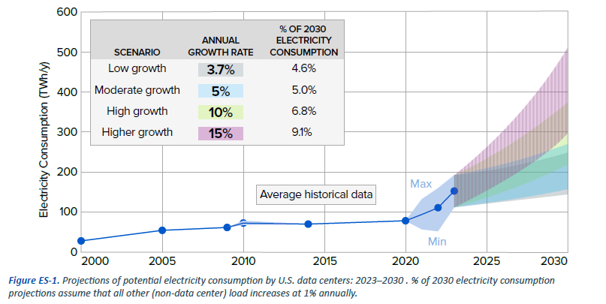

Slide 13
NOTES
Data centers favor sites where internet connections are strong; where electricity prices, land costs, and disruptive events are low; where skilled labor is available; near population centers and users; and where the centers can develop backup power to ensure power supply (usually natural gas or diesel generators).
Key questions:
As the number and size of data centers expand to support continued growth in data processing, internet traffic, and rapid expansion in artificial intelligence (AI) applications, some critical questions emerge:
How rapidly can we expect data centers to expand, and how does the rapid growth in AI change their power demands?
What is the impact of these developments on electric load and resource adequacy?
What implications do these trends have for future electricity infrastructure planning?
How can the data center and electric utility industries work together to support rapid data center expansion?

Slide 14
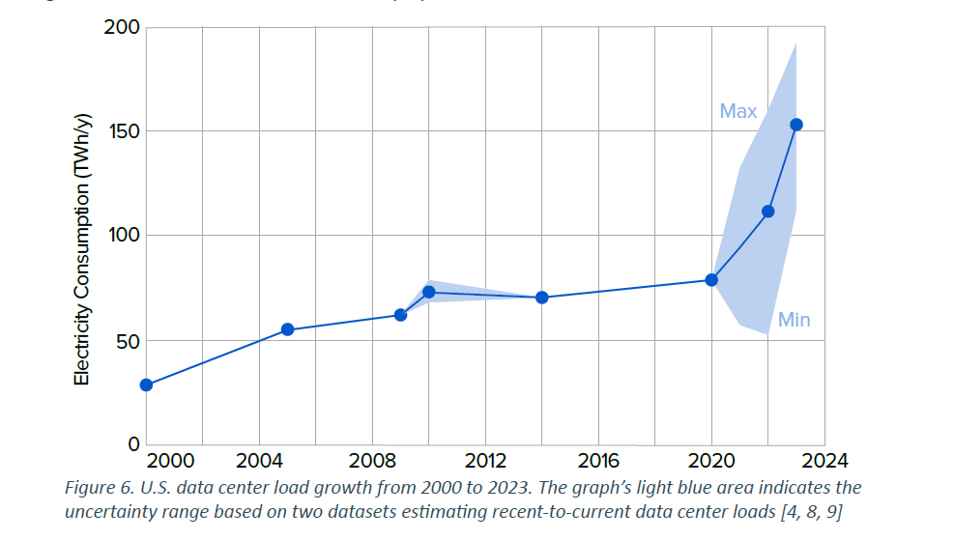
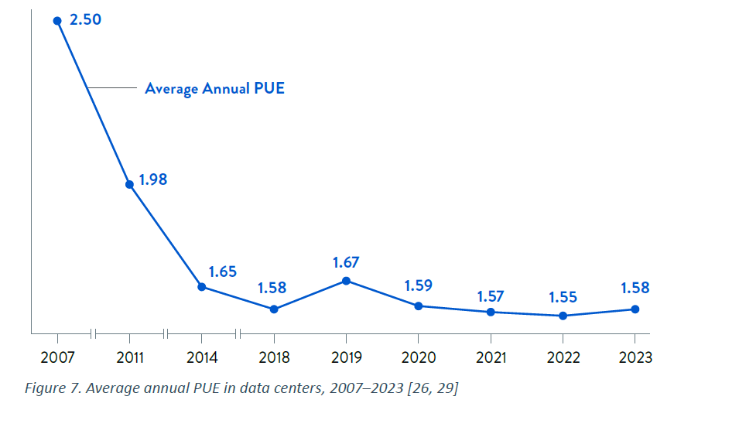
Data Center Intensity Improvement Overview
Recent data from the Uptime Institute highlights an average annual improvement rate of 1–2% in data center energy efficiency, as measured by the Power Usage Effectiveness (PUE) metric. In 2022, the average PUE was reported at 1.55, reflecting a modest decrease in energy intensity across the industry. However, progress in efficiency has slowed in recent years.
Key Points:
PUE as a Metric:
Power Usage Effectiveness (PUE) is the primary measure of data center efficiency.
It is calculated by dividing the total power consumed by a data center by the power used specifically by IT equipment.
Industry Average:
The average PUE in 2022, according to the Uptime Institute, was 1.55.
Annual Improvement Trends:
While there is ongoing improvement, the annual PUE reduction rate remains low, with only minor gains observed in recent years.
Factors Influencing Efficiency Improvements:
Technological Advancements:
Innovations in cooling systems, efficient server designs, and advanced power management technologies can improve PUE significantly.
Operational Practices:
Enhanced operational strategies, including optimized load balancing and regular maintenance, contribute to efficiency gains.
Regulatory Pressures:
Increasing environmental regulations are encouraging data center operators to prioritize energy efficiency.

Slide 15
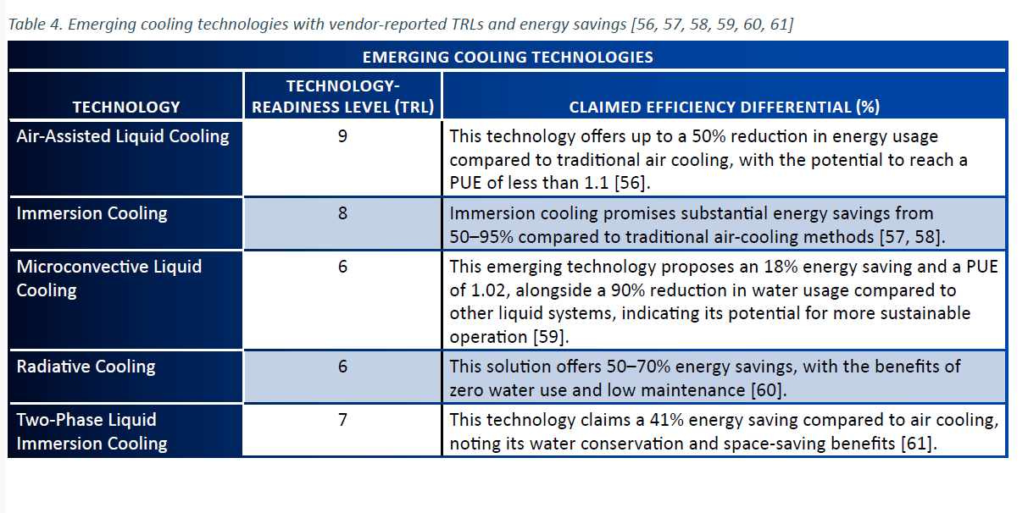

Slide 16
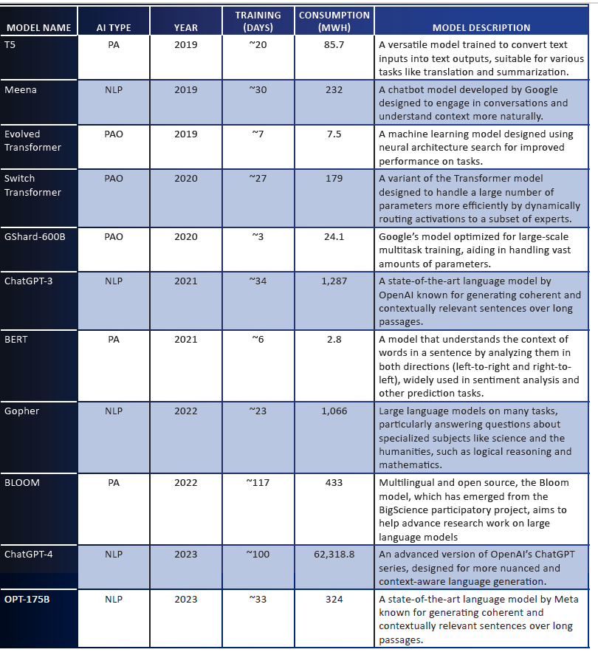

Slide 17
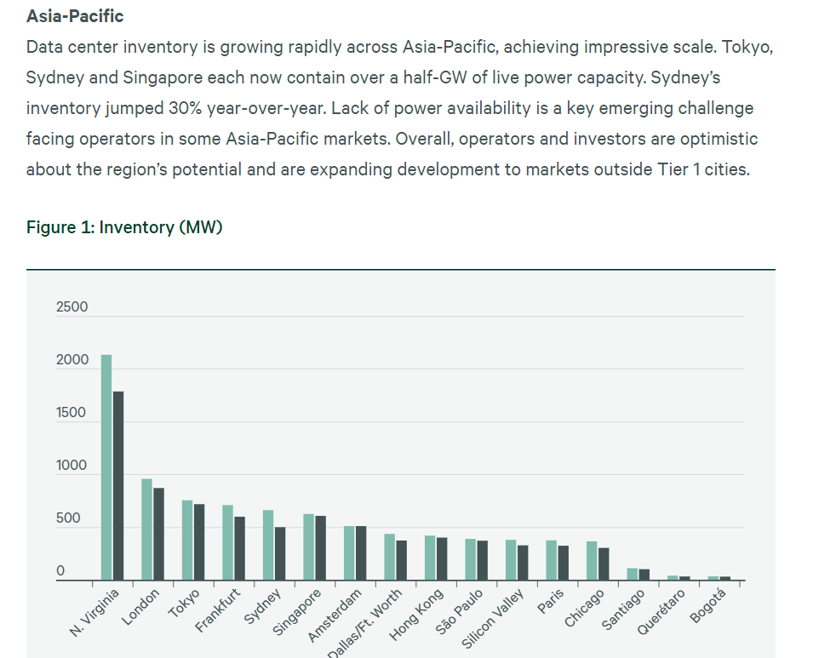
https://www.cbre.com/insights/reports/global-data-center-trends-2023 - this report had a lot of info including a summary of current states of many asia pacific nations with data centres

Slide 18
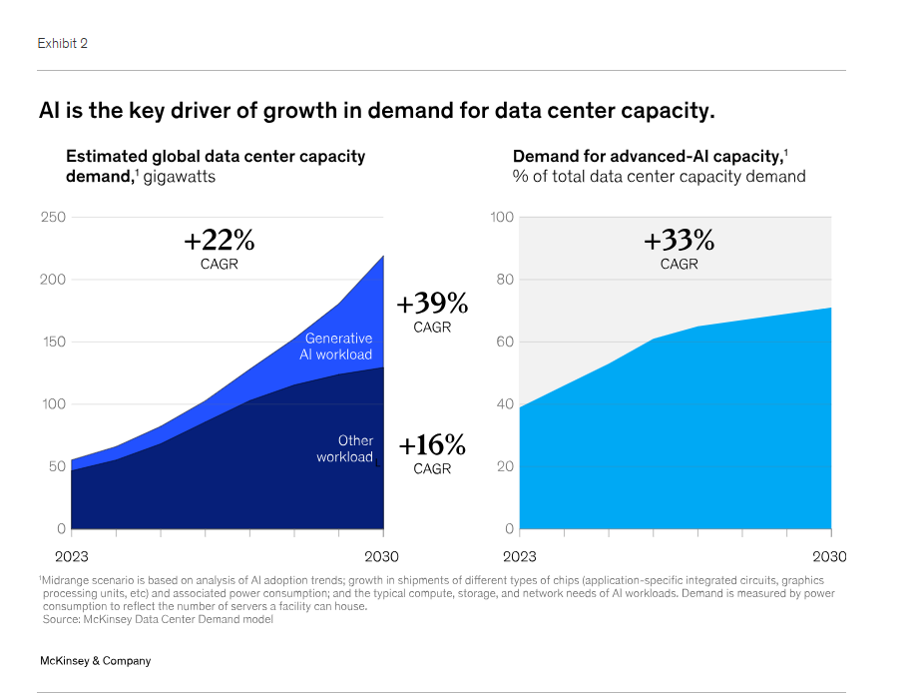

Slide 19
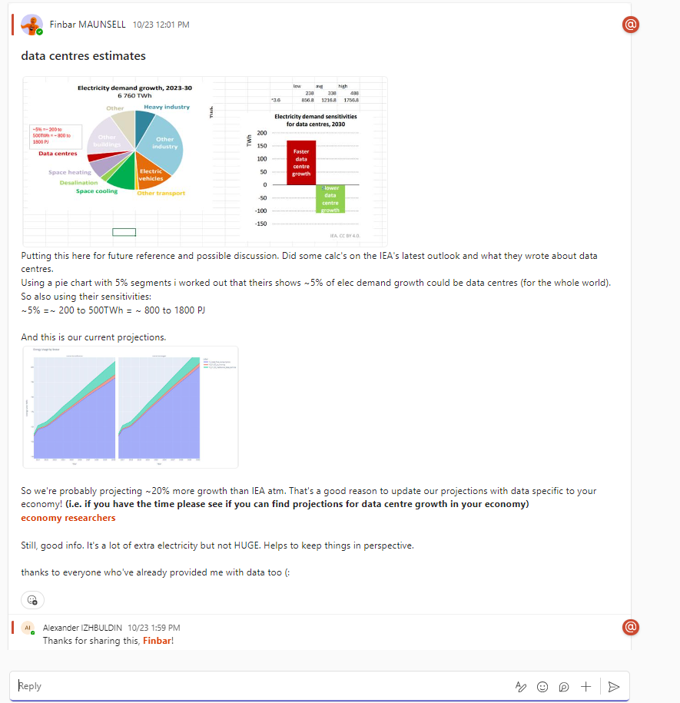
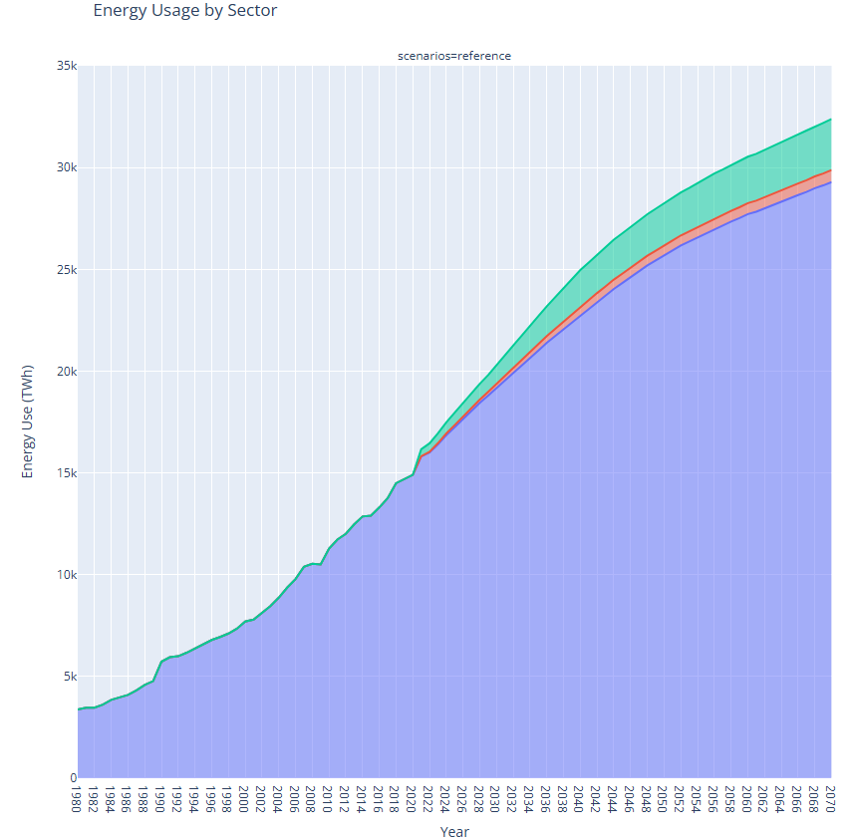
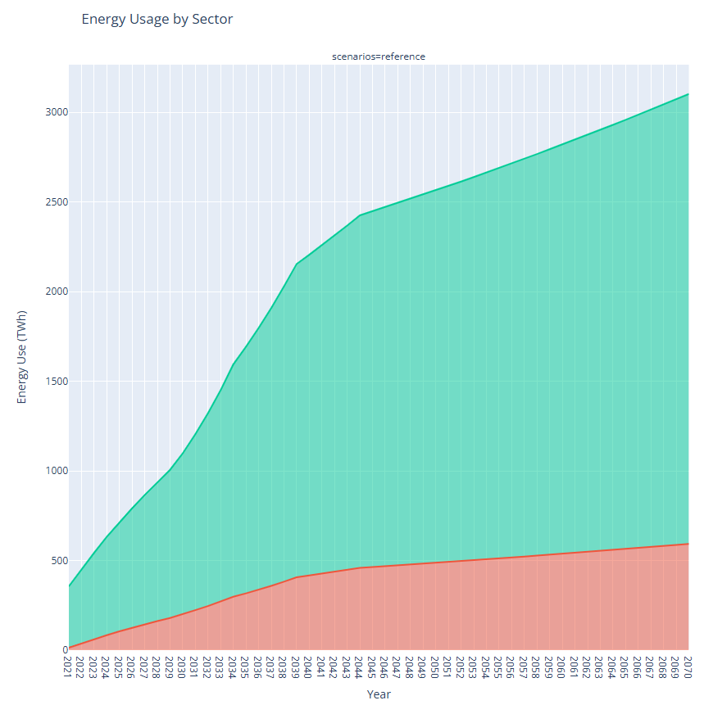
Updated version of that chart: ~1000twh in 2030

Slide 20
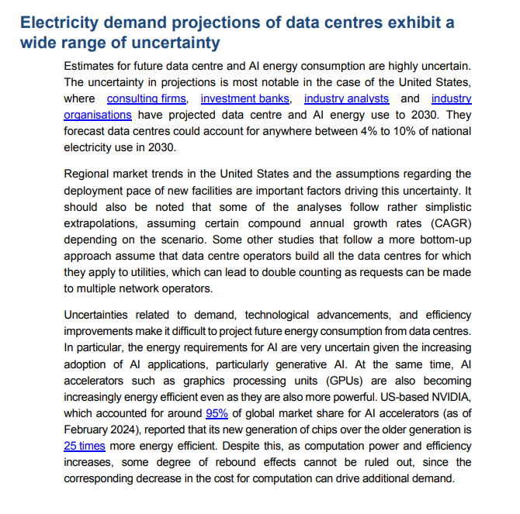
https://www.iea.org/commentaries/what-the-data-centre-and-ai-boom-could-mean-for-the-energy-sector

Slide 21
Conversion factors
1 /8760 – mwh to mw
1*8760 – mw to mwh
Mwh to twh = 1/1e6
Mw to twh = 1*0.00876 , gw to twh = 1*8.76
Twh to mw = 1/0.00876
To produce 1 TWh of energy in a year, you would need 114.155 MW of continuous power. (theres 8760 hours in a year, so mw to mwh is just 1mw*8760h)
1*3.6 – twh to pj (1 twh is 3.6 pj)
Mw to PJ = 1/31.709 (or 1* 0.031536)
Pj to mw = 1*31.709
To produce 1 pj of energy you would need ~0.27778twh which is ~31.709mw

Slide 22
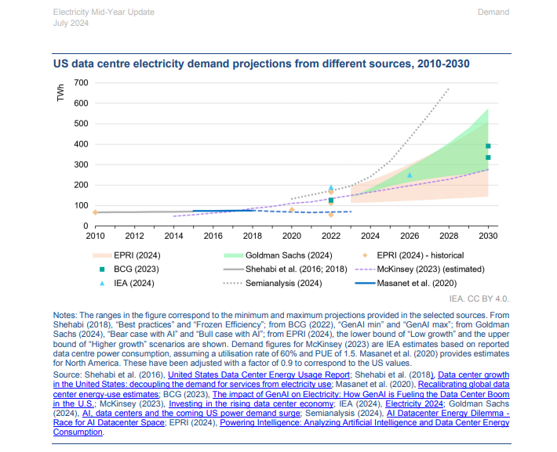
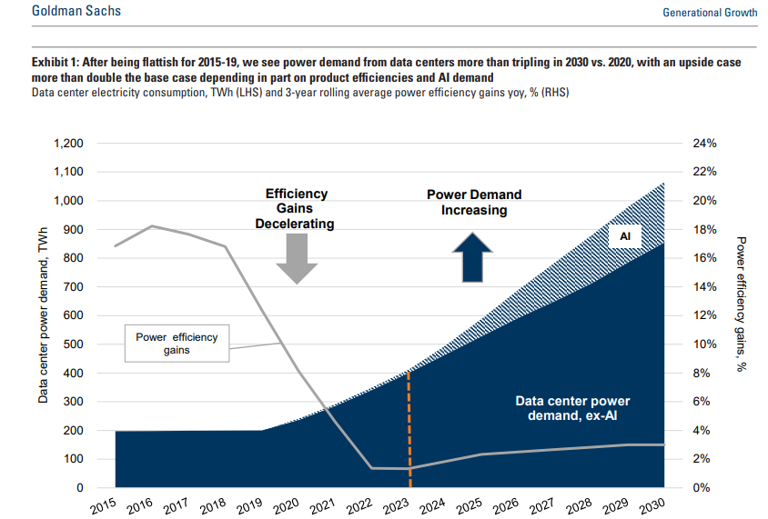
USA
Hi, just as a first estiamte to help understand the general trajectory of aperc total data centres demand i have done USA's projection using this G-Sachs report from May this year:
https://www.goldmansachs.com/pdfs/insights/pages/generational-growth-ai-data-centers-and-the-coming-us-power-surge/report.pdf
https://iea.blob.core.windows.net/assets/234d0d22-6f5b-4dc4-9f08-2485f0c5ec24/ElectricityMid-YearUpdate_July2024.pdf
Lets go with 400twh by 2030. that is 45gw, 45,000mw, 1440pj

Slide 23
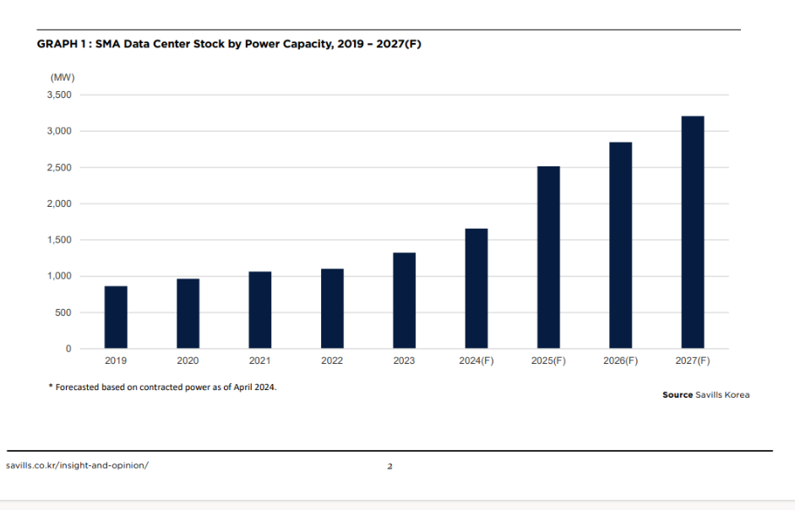
Korea
1h2024-korea-data-centers(en) (2).pdf

Slide 24
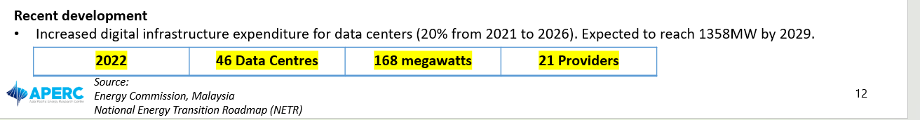
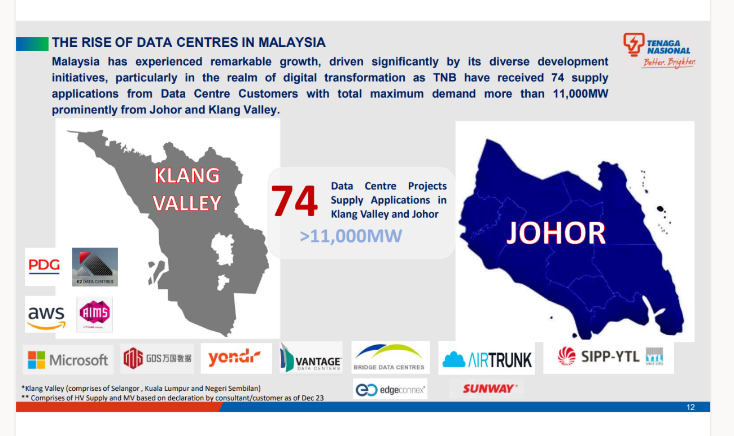
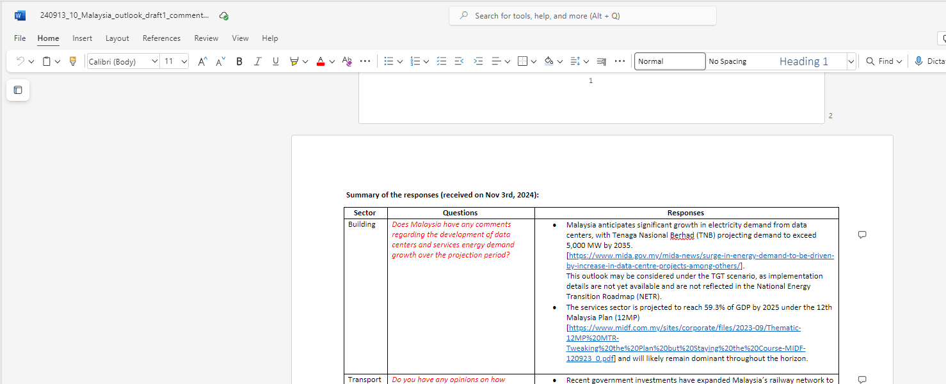
All of these differ from each other. I decided to go with the 5000mw by 2035 one for now
MAS
Key Assumptions MAS.pptx
https://aperc.sharepoint.com/:w:/s/Outlook-9th/ET_-Hl2Z3h1Hro0d5CmSZ1wByz_3GMSX2VQfJfvdNQzWWg?e=fVrgeg
TNB_Sourcing_the_Power_Required_for_GenAi 1.pdf

Slide 25
CT
All throughout here outlook 9th\Drafting\Volume 2\1. First Draft\18 CT\06_External review
Im pretty sure the most data came from a powerpoint

Slide 26
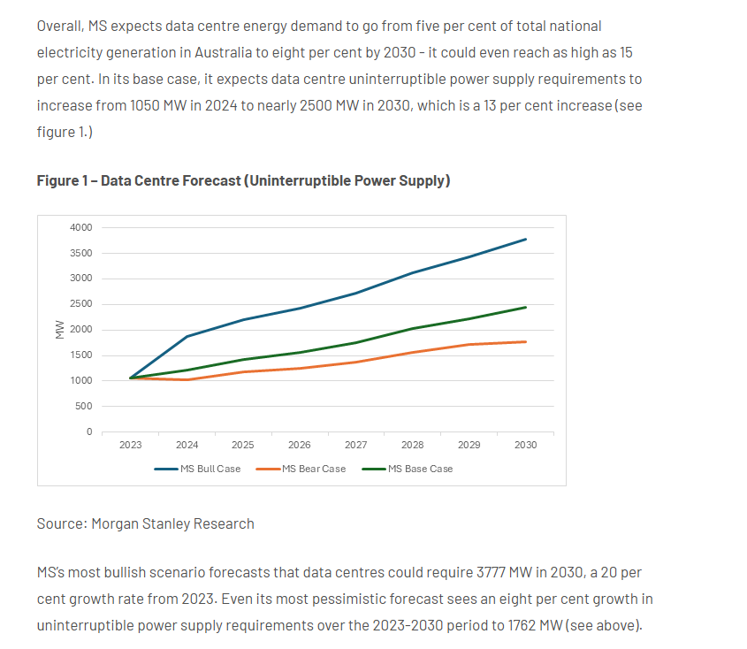
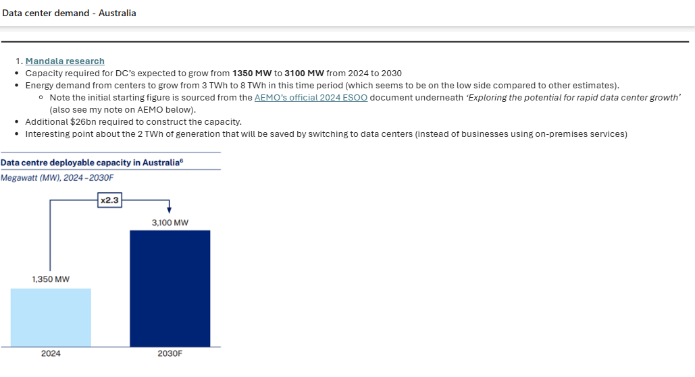
aus
Data center demand - Australia.eml – email from daniel with lots of details.
Notes:
https://www.energycouncil.com.au/analysis/data-centres-and-energy-demand-what-s-needed/ - what finn found

Slide 27
ina
Current State 2024
128 data center registered as PLN customer, with total capacity 948 MVA (~1 GW)
Area of data center is Jakarta, Bekasi (West Java Province) and Batam (Riau Islands Province), Bali and Nusa Tenggara
Projection and Assumption
Ministry of Communication and Informatics assumes growth rate 4.8% p.a from 2024 to 2032
PLN Assumption, data center growth:
Moderat scenario 4 GW to 2032 (4000mw)
Optimistic scenario 12 GW to 2032 (12,000mw)
REF:
https://web.pln.co.id/media/siaran-pers/2024/09/pln-siapkan-listrik-bersih-layani-pertumbuhan-industri-data-center-di-indonesia
https://www.cnbcindonesia.com/tech/20240911105218-39-570932/video-menkominfo-bisnis-data-center-beri-ri-peluang-cuan-usd-337-m

Slide 28
cda

Slide 29
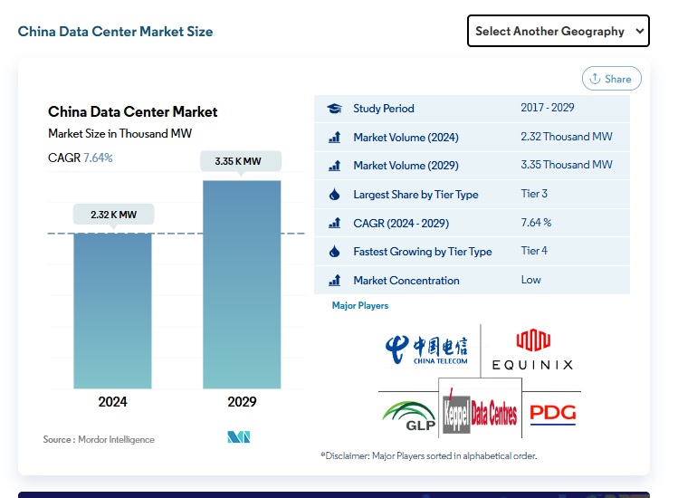
China
https://www.mordorintelligence.com/industry-reports/china-internet-data-center-market?utm_source=chatgpt.com
It actually not much?
2.32* 0.031536 = 0.073pj< don’t think their estimate is correct tbh

Slide 30
Singapore
In Singapore, data centres accounted for around 7% of national electricity use in 2020 - https://iea.blob.core.windows.net/assets/234d0d22-6f5b-4dc4-9f08-2485f0c5ec24/ElectricityMid-YearUpdate_July2024.pdf

Slide 31
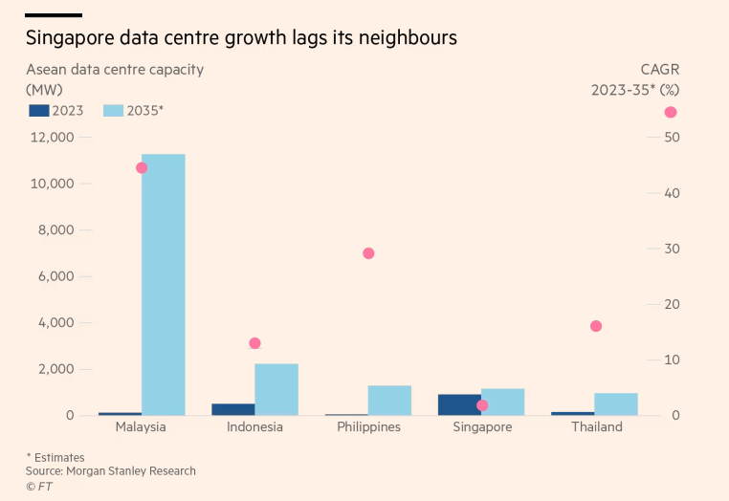
sea
From this extracted: ~1200mw for Thailand by 2035
~1500 for sg
~1600 for phl
2200 for ina
11000 for mas

Slide 32
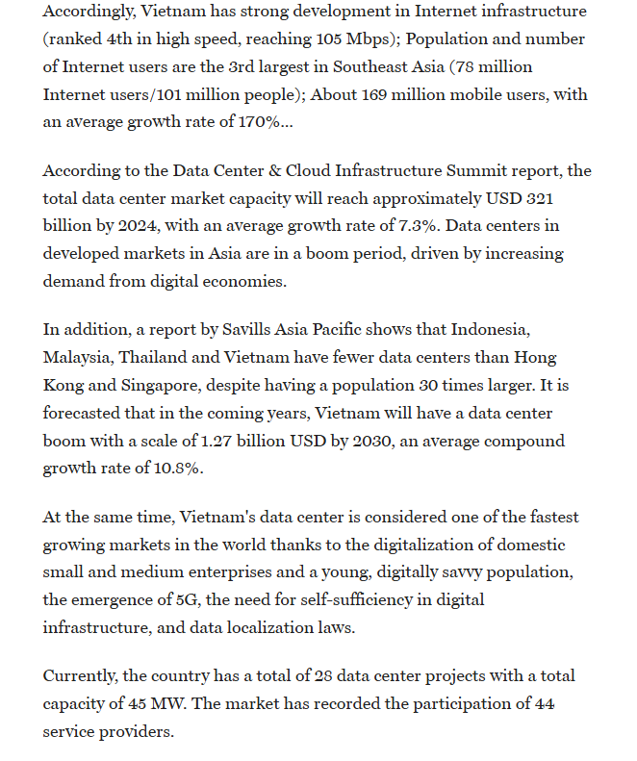


vietnam
45 *0.031536 = 1.419pj preexisting capacity
https://vneconomy.vn/trung-tam-du-lieu-duoc-thuc-day-boi-kinh-te-so-va-ha-tang-so.htm

